Slide 1
SAP UI5 – Intermediate Level

Slide 2
SAP UI5 – Day 1

Slide 3
UI5I-OVW: SAP UI5 Walkthrough

Slide 4
Agenda
Controls and Libraries- UI demokit walkthrough in detail
Lifecycle Hooks- onInit, onBefore rendering, onAfter rendering, onExit
Chrome developer tool
Demo for creating a hello world project on UI5 on HCP Webide
Component.js concept

Slide 5
UI5I-OVW-01 : UI5 Controls and Libraries

Slide 6
Controls & Libraries
There are different types of UI controls that you can use while developing UI5 applications. These controls allow you to add a button, table, images, layout, combo box, and various other controls in UI5 application.
Common control types include −
Simple Controls
Complex Controls
UX3 Controls
Dialogs
Layout

Slide 7
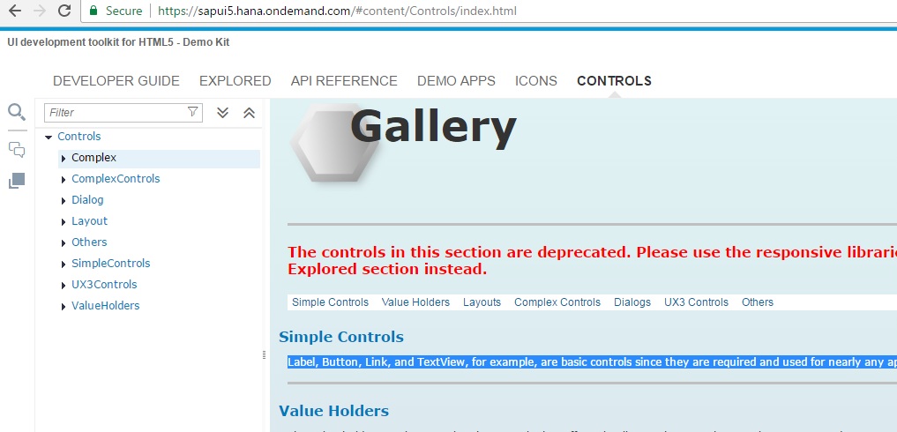
Simple control
Label, Button, Link, and TextView are basic controls since they are required and used for nearly any application design.

Slide 8
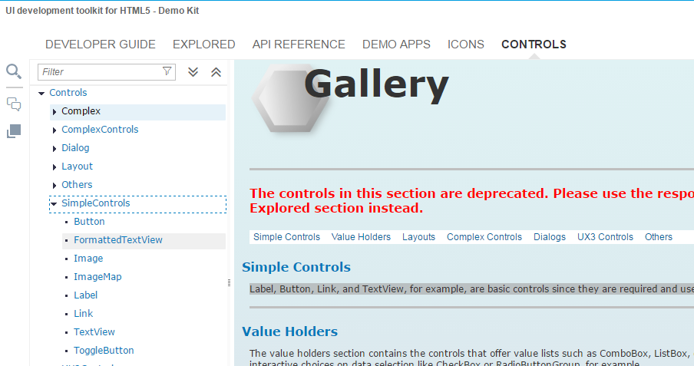
Simple control

Slide 9
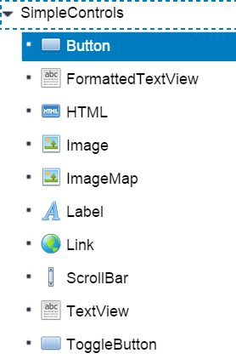


Simple control
Decorative Image With Company Logo
Buttons

Slide 10
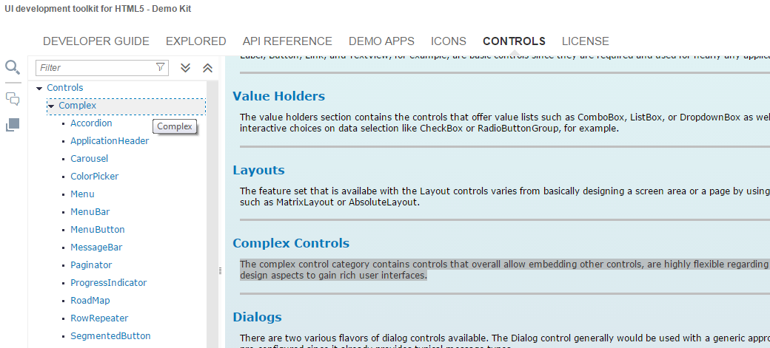
Complex control
The complex control category contains controls that overall allow embedding other controls, are highly flexible regarding content display, and allow to mix various design aspects to gain rich user interfaces.

Slide 11
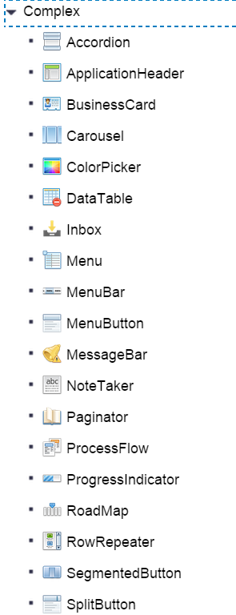
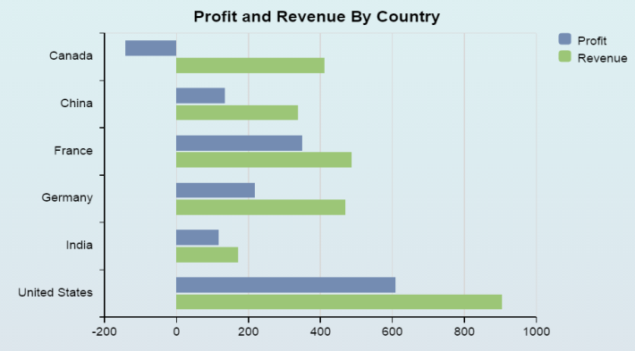
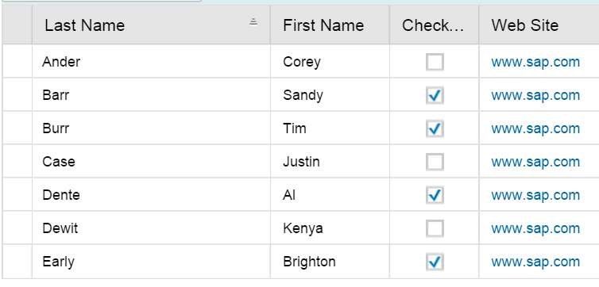
Complex control
Bar chart
Table

Slide 12
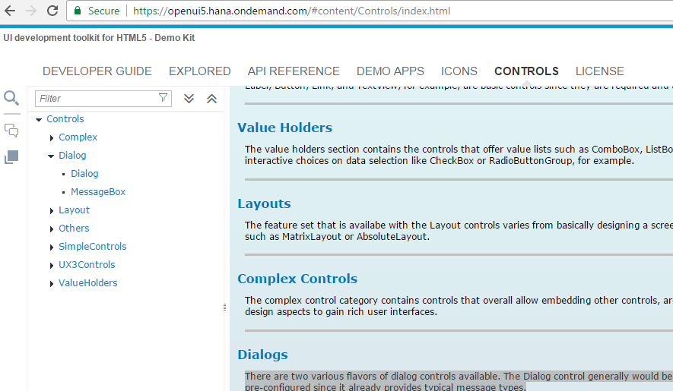
Dialog control
There are two various flavors of dialog controls available. The Dialog control generally would be used with a generic approach where the MessageBox is kind of pre-configured since it already provides typical message types.

Slide 13
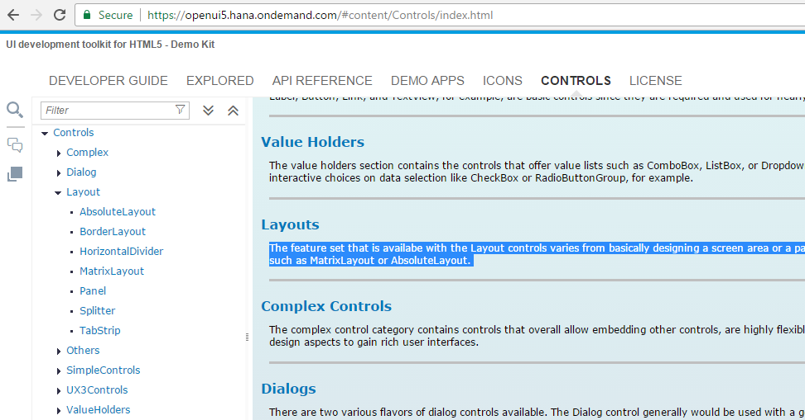
Layouts control
The feature set that is availabe with the Layout controls varies from basically designing a screen area or a page by using a divider, to providing complex layouts such as MatrixLayout or AbsoluteLayout.

Slide 14
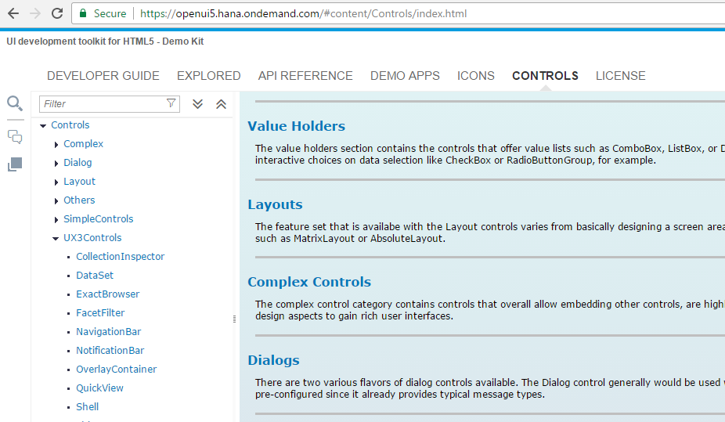
Ux3 control
Here the new UX3 Patterns like Shell, ThingInspector or ExAct are described.

Slide 15
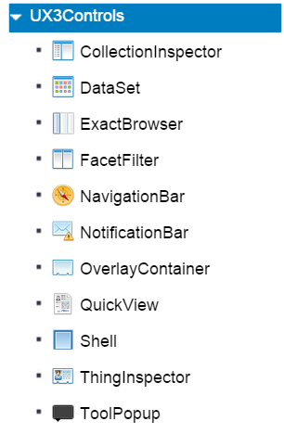
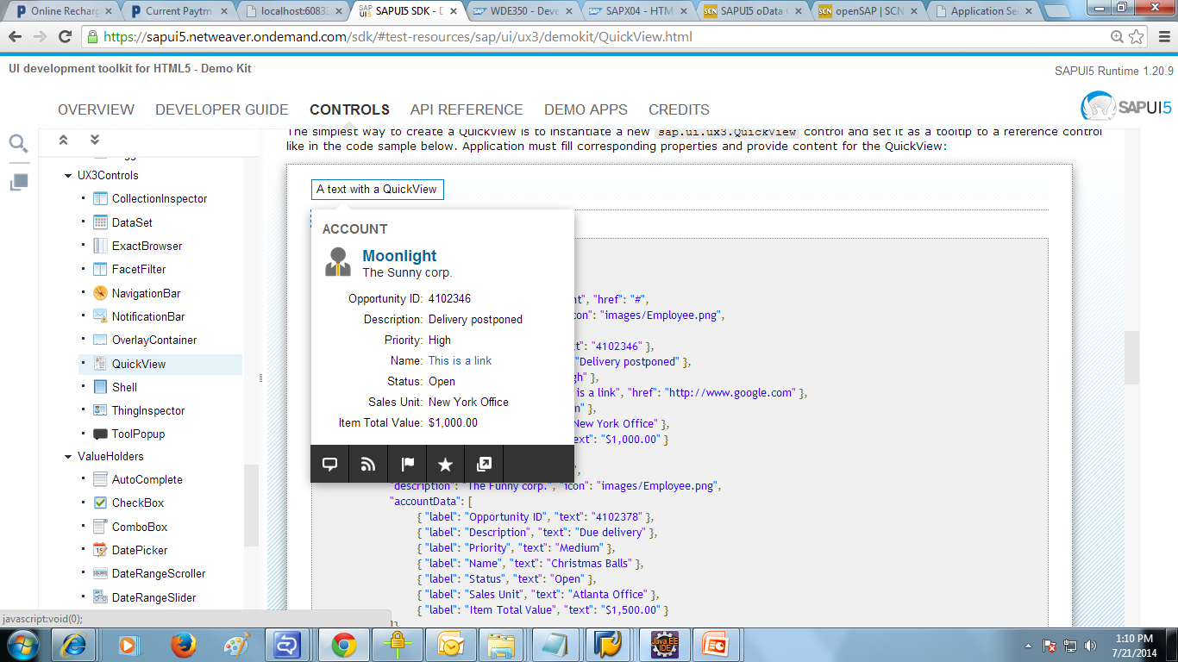
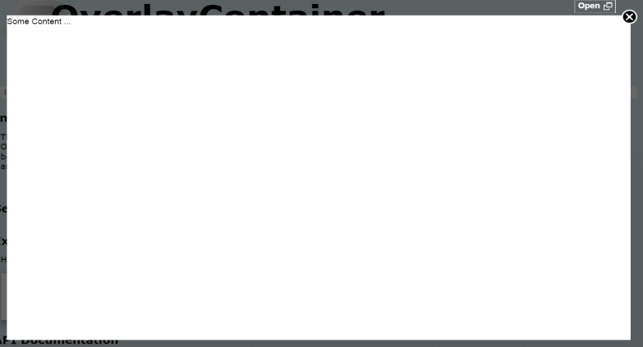
Ux3 control
Quick View
Overlay Container

Slide 16
Libraries
There are various JavaScript and CSS libraries that you can use in combination for the application development. SAPUI5 can use these libraries in combination and they are called SAPUI5 control libraries.
Common SAPUI5 control libraries −
sap.ui.core : This library contains the jQuery plugins (jQuery.sap.*), the core and all its components, base classes for controls, components and the Model-View-Controller (MVC) classes.
sap.m : controls designed for mobile devices and tablets ,can also be used for desktop.
sap.ui.layout : contains all layout controls can be combined with other libraries
sap.ui.model : It is SAP UI5 Data binding API.
sap.ui.table : It contains all the table controls
sap.ui.view : Creates a view of the given type, name and with the given id.

Slide 17
Control library Combinations
You can use the control library sap.m with other control libraries - sap.ui.unified, sap.viz, sap.ui.layout, and sap.suite.
You can combine control libraries – sap.m, sap.ui.table, sap.ui.ux3 and sap.ui.suite with each other.
You can also combine control library sap.m and sap.ui.ux3 with other libraries like sap.ui.core, sap.ui.unified, sap.ui.layout, and sap.ui.table.
You can combine sap.viz with all other libraries.

Slide 18
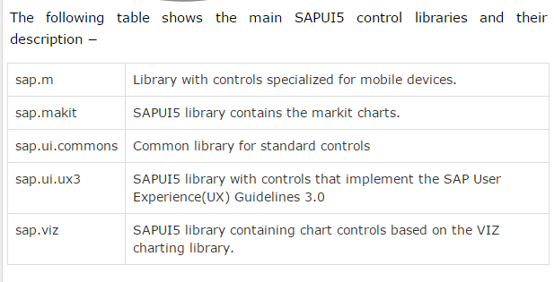
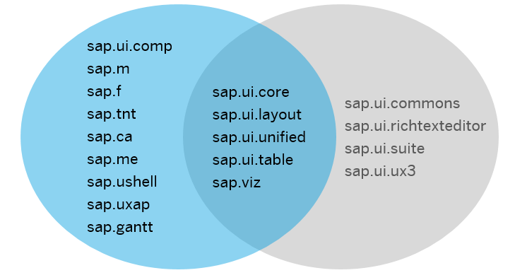
Control library Combinations

Slide 19
UI5I-OVW-02 : Lifecycle hooks of View

Slide 20
Lifecycle Hooks:
onInit(): Called when a view is instantiated and its controls (if available) have already been created; used to modify the view before it is displayed to bind event handlers and do other one-time initialization
onExit(): Called when the view is destroyed; used to free resources and finalize activities

Slide 21
Lifecycle Hooks:
onAfterRendering(): Called when the view has been rendered and, therefore, its HTML is part of the document; used to do post-rendering manipulations of the HTML. SAPUI5 controls get this hook after being rendered.
onBeforeRendering(): Invoked before the controller view is re-rendered and not before the first rendering; use onInit() for invoking the hook before the first rendering

Slide 22
Chrome developer tools and debugging UI5 applications:
Elements section- Gives you the detail of the HTML DOM structure and CSS properties
Networks- All the get and Post call the browser is making
Sources- To see all the scripts
Resources- Cookies and Local storage
Console
Break points
Use shortcut keys for debugging

Slide 23
UI5I-OVW-03 : Concept of Component.js file

Slide 24
Component.js
The Component.js file is the component controller and provides the runtime metadata and the component methods.
A component controller is defined with the asynchronous module definition (AMD) syntax. In the sap.ui.define statement; the required dependencies can be declared which can be used in the controller.
To create an SAPUI5 component, you extend either the Component or UIComponent base class and pass the name of the module (namespace + .Component).

Slide 25
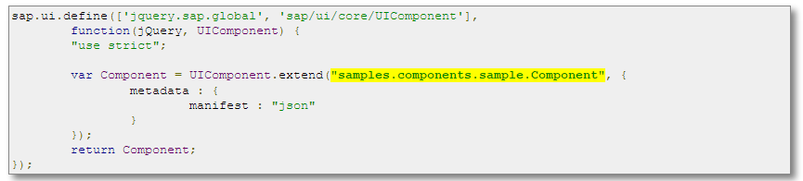
Component.js

Slide 26
UI5I-OVW-04 : Creating Simple UI5 Apps - exercise

Slide 27
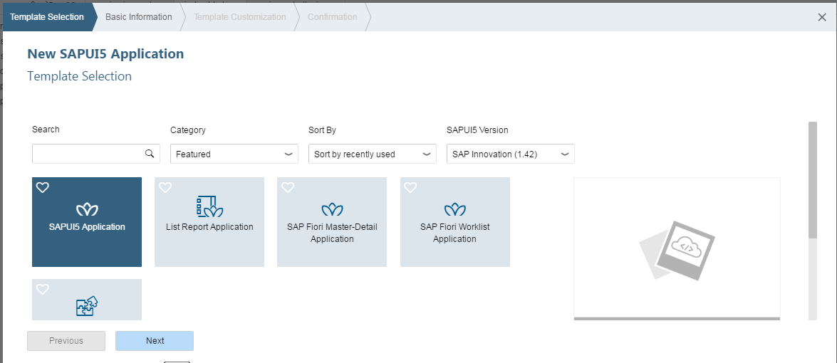
Hello world

Slide 28
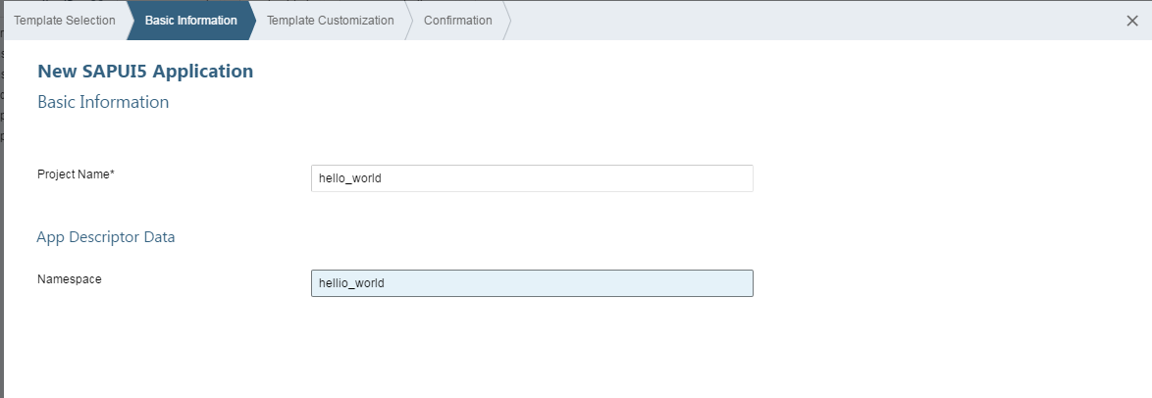
Hello world

Slide 29
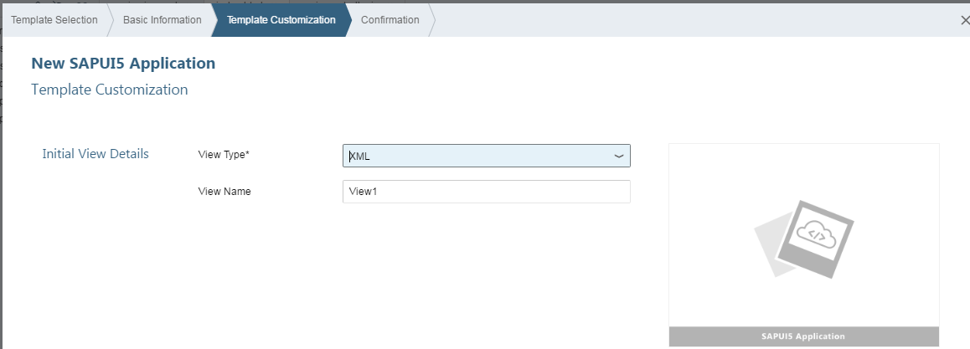
Hello world

Slide 30
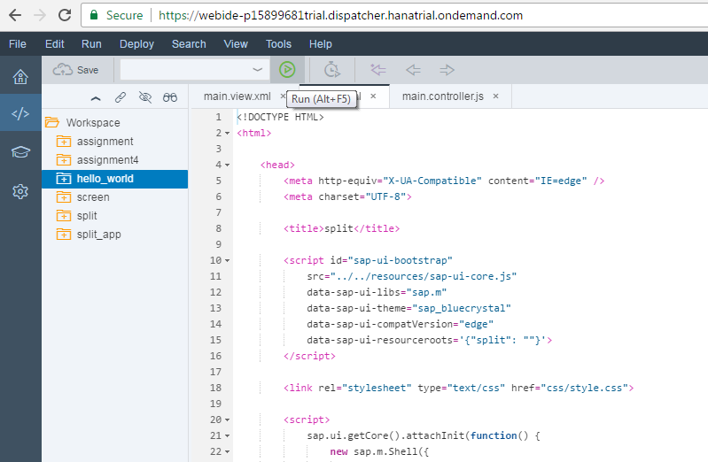
Hello world

Slide 31
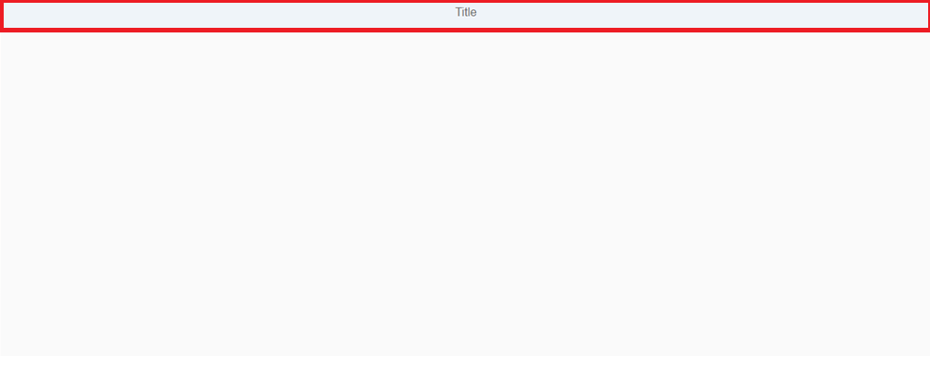
Output of Hello world

Slide 32
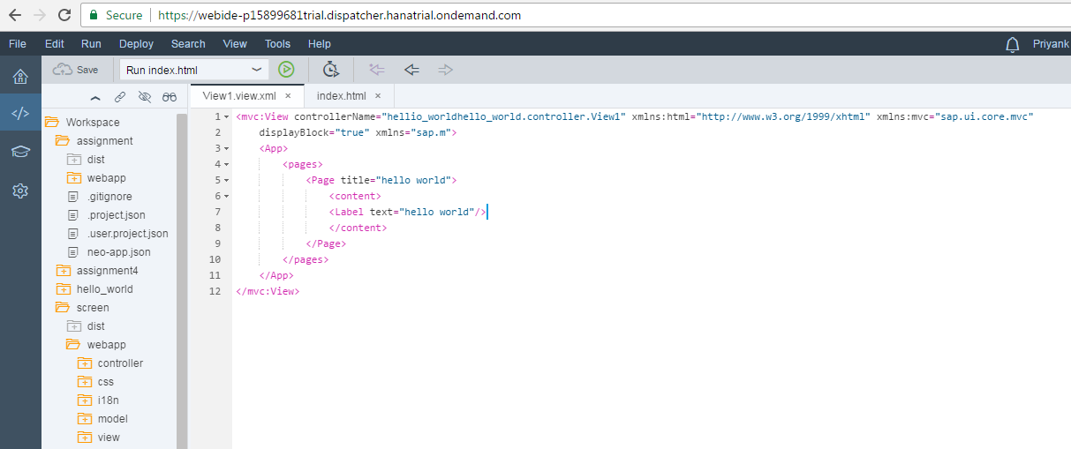
Hello world

Slide 33
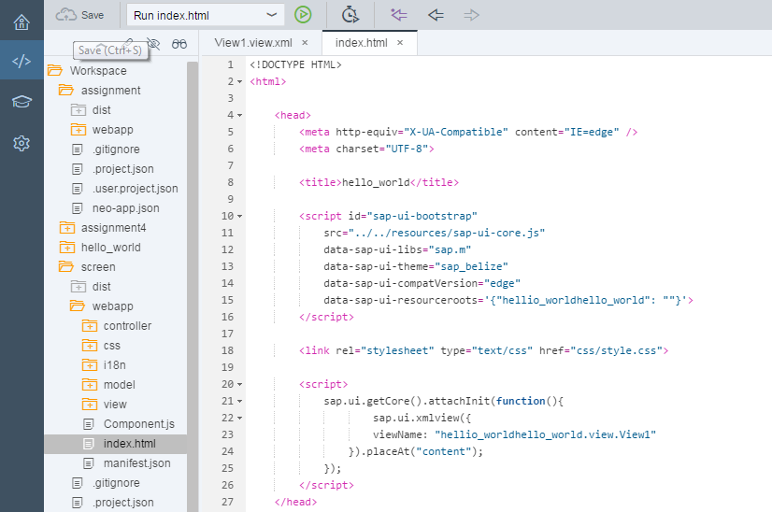
Hello world

Slide 34
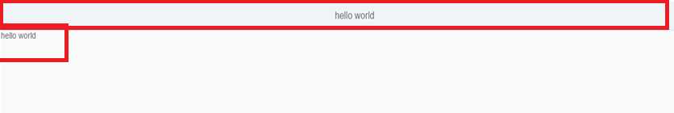
Output of Hello world

Slide 35
Useful links
SAP UI5 Demo kit- https://sapui5.hana.ondemand.com/sdk/#content/Controls/index.html
SCN Community page- http://scn.sap.com/community/developer-center/front-end
SAP UI5 testsuite- https://sapui5.hana.ondemand.com/sdk/test-resources/testsuite/testframe.html
Creating SAP UI5 Project http://scn.sap.com/docs/DOC-37805

Slide 36

Questions???

Slide 37


